Slide 1


R VISWANATHAN
DEPARTMENT OF ARTIFICIAL INTELLIGENCE AND DATA SCIENCE
DR.MAHALINGAM COLLEGE OF ENGINEERING AND TECHNOLOGY,POLLACHI

Slide 2
Introduction
Convolutional neural network is a class of deep, feed-forward artificial neural networks.
CNNs, like neural networks, are made up of neurons with learnable weights and biases.
CNN has an input layer, number of hidden layers, and an output layer.
Each neuron receives numerous i/p, take a weighted sum and passes it through an activation function.
The architecture of a ConvNet is analogous to that of the connectivity pattern of neurons in Human Brain & was inspired by the organization of the Visual Cortex.
The role of ConvNet is to reduce the images into a form which is easier to process without losing features which are critical for getting a good prediction.
The objective of the convolution operation is to extract the high-level features such as edges from the i/p image
Notes:
ConvNet is not limited to only one Convolution Layer.
Visual Cortex: individual neurons respond to stimuli only in restricted region of the visual field known as the Receptive Field.
The Ist ConvLayer is responsible for capturing the Low-level features such as edges, color, gradient orientations ect
With added layers, the architecture adapts to the High-level features giving the wholesome understanding of images in the dataset.

Slide 3
Components of CNN
Convolutional layer
Pooling or downsampling layer
Flattening layer
Fully connected layer

Slide 4
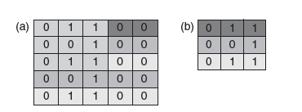
Convolution Layer
CNN is Neural Network with some convolutional layers(and some other layers).
A Convolution layers has a number of filters that does convolution operation.
Filters or kernels are the base units in this system.
These layers consist of a series of learnable filters.
Convolution is done by computing the dot product between the input matrix and filter or kernal.
(a) Input Matrix b) filter or kernel

Slide 5
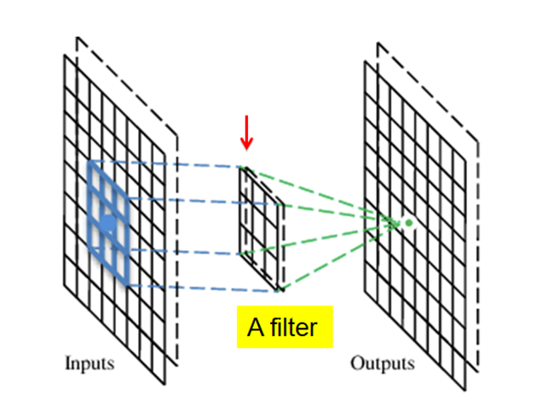
Convolution Layer

Slide 6
Feature Map
The size of the feature map (convolved feature) is controlled by three parameters
Depth
Corresponds to the number of filters used for the convolution operation.
Stride
The rate at which kernel passes
Zero Padding
Zero-padding on the outside of the image to make sure that kernel pass is perfect on the edges
Notes:
Stride: when the stride is 1 then the filter are moved one pixel at a time….when the stride is 2 then the filter is jumped 2 pixels at a time…
Larger the stride –it produces a smaller feature maps.

Slide 7
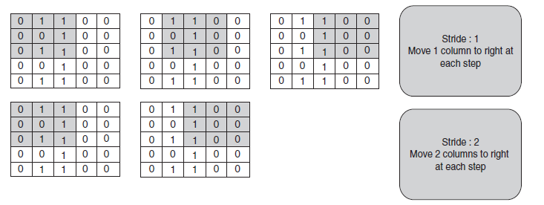
Representation of stride

Slide 8
Padding
Zero padding is the process of adjusting the input size as per the requirement by adding zeros to the i/p matrix.
Sometimes filter does not perfectly fit the input image.
2 types:
Valid Padding: keeps only the valid part of the image.
Same Padding: Dimensionality is either increased/ remains the same.
Notes:
Its mostly used in designing the CNN layers when the dimensions of the input volume need to be preserved in the output volume.
In that case, we need to either pad the picture with zeros so that it fits or drop the part
Valid padding: it reduces the dimensionality
Same Padding: if we augment the 5*5*1 image into a 6*6*1 image and then apply 3*3*1 kernel over it, our convolved matrix turns out to be dimension 5*5*1---which is same as the original image.

Slide 9
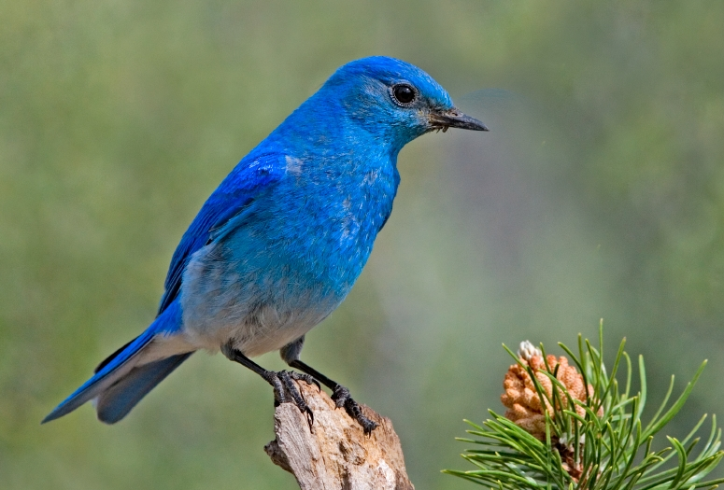

Pooling or Down sampling Layer
Pooling Layer function is to progressively reduce the spatial size of the representation to reduce the number of parameters and computation in the network.
Hence to also control overfitting.
Spatial pooling is called subsampling or downsampling.
It reduces the dimensionality of each map but retains the important information.
Subsampling

Slide 10
Types of Pooling
Max-Pooling:
returns the maximum value from the portion of the image covered by the kernel.
Average Pooling:
Returns the average of all the values from the portion of the image covered by the kernel.
Average pooling works well for straight lines and smaller curves, but cannot detect extreme features like sharp edges.
Sum Pooling:
The sum of all elements in the feature map is called sum pooling.
Notes:
Sum Pooling:
Max pooling takes the maximum value from the input region, whereas sum pooling uses the sum of the values in the input region.
Both max pooling and sum pooling decreases the dimension of the input data while efficiently retaining the features.

Slide 11
Flattening Layer
Having extracted the features from the convolution layer and reduced the dimension by the pooling layer it’s the time for classification.
The fully connected layers cannot process multi-dimensional data.
So the data should be reduced down to single dimension(flattened) for each channel before processing.
Notes:
Fully Connected Layer : implies that every neuron in the previous layer is connected to every neuron on the next layer.
softmax activation function in the output layer ---implies the sum of the output probabilities from the fully connected layer is 1.

Slide 12
Fully Connected Layer
Neurons in a fully connected layer have full connections to all activations in the previous layer as in regular neural networks.
It’s a traditional MultiLayer Perceptron(MLP) that uses softmax activation function in the output layer.
The purpose of the fully connected layer is to use the high level features from convolution and pooling layers for classifying the input image.
The fully connected layers cannot process multi-dimensional data.
So the data should be reduced down to single dimension(flattened) for each channel before processing.

Slide 13
Activation Function
Its important for an ANN to learn and understand the complex patterns.
Activation layer is applied immediately after each convolution layer to introduce non linearity in the convolution layers.
Now a days ReLU is mostly used as it alleviates the vanishing gradient problem.
F(x)=max(0,x)
Variants of ReLU
Leaky ReLU
It fixes the dying ReLU problem, as it does not have zero-slope parts.
It speeds up training.
Randomized ReLU
Notes:
Types of activation function
Linear Activation function/ Identity Function F(x)=x
Step Function F(x)=1 if x>0
Non –linear activation function:
Sigmoid logistic activation function
Hyperbolic tangent function- Tanh
ReLu –Rectified Linear Unit.
vanishing gradient problem---the lower layers of the network train slowly because the gradient decreases exponentially through the layers.
F(x)=max(0,x)----It changes all the negative activations to 0.
Leaky ReLU---- activation value is 0.01….
They have a small slop for negative values, instead of altogether zero.
RandomizedReLu----

Slide 14
Let us understand the process of convolution with an example
These are the network parameters to be learned.
1 | 0 | 0 | 0 | 0 | 1
0 | 1 | 0 | 0 | 1 | 0
0 | 0 | 1 | 1 | 0 | 0
1 | 0 | 0 | 0 | 1 | 0
0 | 1 | 0 | 0 | 1 | 0
0 | 0 | 1 | 0 | 1 | 0
Filter 1
1 | -1 | -1
-1 | 1 | -1
-1 | -1 | 1
3 x 3
6 x 6 image

Slide 15
Convolution
Filter 1
1 | -1 | -1
-1 | 1 | -1
-1 | -1 | 1
stride=1
1 | 0 | 0 | 0 | 0 | 1
0 | 1 | 0 | 0 | 1 | 0
0 | 0 | 1 | 1 | 0 | 0
1 | 0 | 0 | 0 | 1 | 0
0 | 1 | 0 | 0 | 1 | 0
0 | 0 | 1 | 0 | 1 | 0
Dot
product
3
-1
6 x 6 image

Slide 16
Convolution
Filter 1
If stride=2
1 | -1 | -1
-1 | 1 | -1
-1 | -1 | 1
1 | 0 | 0 | 0 | 0 | 1
0 | 1 | 0 | 0 | 1 | 0
0 | 0 | 1 | 1 | 0 | 0
1 | 0 | 0 | 0 | 1 | 0
0 | 1 | 0 | 0 | 1 | 0
0 | 0 | 1 | 0 | 1 | 0
3
-3
6 x 6 image

Slide 17
Convolution
Filter 1
1 | -1 | -1
-1 | 1 | -1
-1 | -1 | 1
stride=1
1 | 0 | 0 | 0 | 0 | 1
0 | 1 | 0 | 0 | 1 | 0
0 | 0 | 1 | 1 | 0 | 0
1 | 0 | 0 | 0 | 1 | 0
0 | 1 | 0 | 0 | 1 | 0
0 | 0 | 1 | 0 | 1 | 0
3
-1
-3
-1
-3
1
0
-3
-3
-3
0
1
3
-2
-2
-1
6 x 6 image

Slide 18
Convolution
Filter 2
-1 | 1 | -1
-1 | 1 | -1
-1 | 1 | -1
stride=1
Repeat this for each filter
1 | 0 | 0 | 0 | 0 | 1
0 | 1 | 0 | 0 | 1 | 0
0 | 0 | 1 | 1 | 0 | 0
1 | 0 | 0 | 0 | 1 | 0
0 | 1 | 0 | 0 | 1 | 0
0 | 0 | 1 | 0 | 1 | 0
3
-1
-3
-1
-1
-1
-1
-1
-3
1
0
-3
-1
-1
-2
1
Feature
Map
-3
-3
0
1
-1
-1
-2
1
-2
-2
-1
6 x 6 image
3
-1
0
-4
3
Two 4 x 4 images
Forming 2 x 4 x 4 matrix

Slide 19
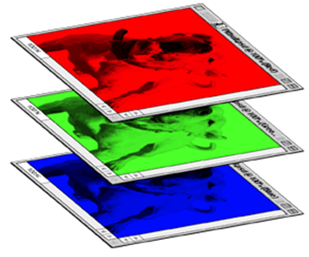
Color image: RGB 3 channels
1 | -1 | -1
-1 | 1 | -1
-1 | -1 | 1
1 | -1 | -1
-1 | 1 | -1
-1 | -1 | 1
1 | -1 | -1
-1 | 1 | -1
-1 | -1 | 1
Filter
Color image
1 | 0 | 0 | 0 | 0 | 1
0 | 1 | 0 | 0 | 1 | 0
0 | 0 | 1 | 1 | 0 | 0
1 | 0 | 0 | 0 | 1 | 0
0 | 1 | 0 | 0 | 1 | 0
0 | 0 | 1 | 0 | 1 | 0
1 | 0 | 0 | 0 | 0 | 1
0 | 1 | 0 | 0 | 1 | 0
0 | 0 | 1 | 1 | 0 | 0
1 | 0 | 0 | 0 | 1 | 0
0 | 1 | 0 | 0 | 1 | 0
0 | 0 | 1 | 0 | 1 | 0
1 | 0 | 0 | 0 | 0 | 1
0 | 1 | 0 | 0 | 1 | 0
0 | 0 | 1 | 1 | 0 | 0
1 | 0 | 0 | 0 | 1 | 0
0 | 1 | 0 | 0 | 1 | 0
0 | 0 | 1 | 0 | 1 | 0

Slide 20
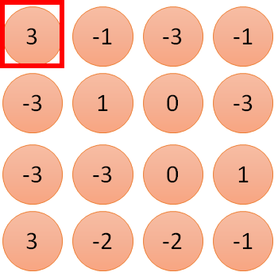
1 | -1 | -1
-1 | 1 | -1
-1 | -1 | 1
1
1
Filter 1
2
0
3
0
3
4:
0
1 | 0 | 0 | 0 | 0 | 1
0 | 1 | 0 | 0 | 1 | 0
0 | 0 | 1 | 1 | 0 | 0
1 | 0 | 0 | 0 | 1 | 0
0 | 1 | 0 | 0 | 1 | 0
0 | 0 | 1 | 0 | 1 | 0
…
0
8
1
9
0
10:
0
…
13
0
6 x 6 image
14
0
fewer parameters!
15
Only connect to 9 inputs, not fully connected
1
16
1
…

Slide 21
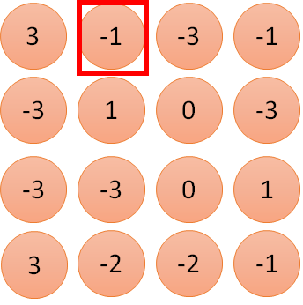
1 | -1 | -1
-1 | 1 | -1
-1 | -1 | 1
1:
1
Filter 1
2:
0
3:
0
3
4:
0
1 | 0 | 0 | 0 | 0 | 1
0 | 1 | 0 | 0 | 1 | 0
0 | 0 | 1 | 1 | 0 | 0
1 | 0 | 0 | 0 | 1 | 0
0 | 1 | 0 | 0 | 1 | 0
0 | 0 | 1 | 0 | 1 | 0
…
7:
0
8:
1
-1
9:
0
10:
0
…
13:
0
6 x 6 image
14:
0
Fewer parameters
15:
1
16:
1
Shared weights
Even fewer parameters
…

Slide 22
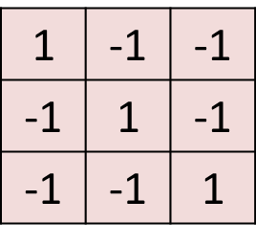
Max Pooling
1 | 0 | 0 | 0 | 0 | 1
0 | 1 | 0 | 0 | 1 | 0
0 | 0 | 1 | 1 | 0 | 0
1 | 0 | 0 | 0 | 1 | 0
0 | 1 | 0 | 0 | 1 | 0
0 | 0 | 1 | 0 | 1 | 0
Conv
3
-1
-3
-1
6 x 6 image
-3
1
0
-3
-3
-3
0
1
3
-2
-2
-1
Filter\ Kernel
2 x 2 image
3
0
Max
Pooling
3
1

Slide 23
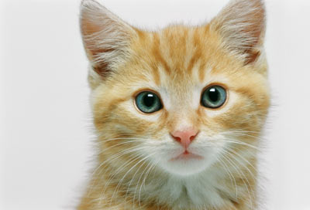
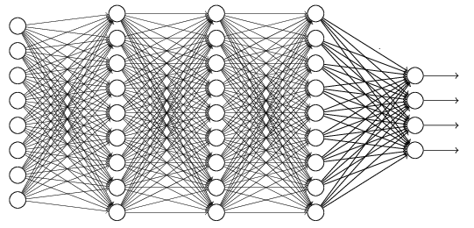
The whole CNN
cat dog ……
Convolution
Max Pooling
Fully Connected Feedforward network
A new image
Convolution
Max Pooling
Flattened
A new image

Slide 24


CNN Implementation
Input
1 x 28 x 28
Convolution
25 x 26 x 26
Max Pooling
25 x 13 x 13
Convolution
50 x 11 x 11
Max Pooling
50 x 5 x 5

Slide 25
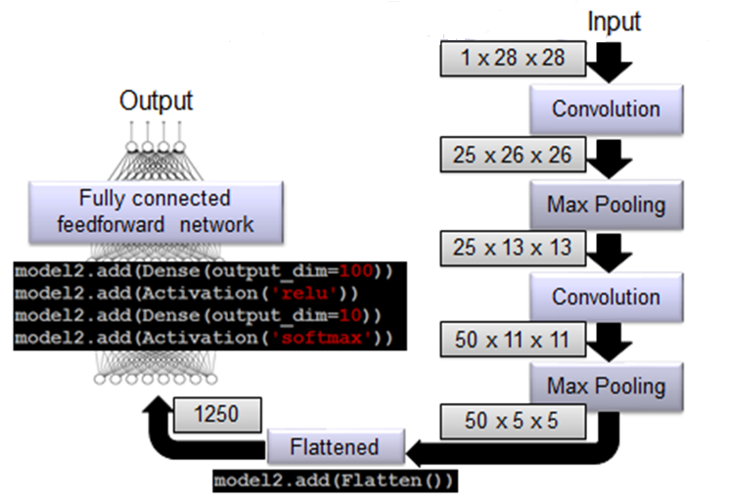
The whole CNN

Slide 26
Research and Application perspective

Slide 27
Case Study on Image Classification using CNN
CIFAR-10 Dataset:
The CIFAR-10 dataset contains 60,000 32 × 32 color images in 10 classes, with 6,000 images per class.
There are 50,000 training images and 10,000 test images.
The dataset is divided into five training batches and one test batch, each with 10,000 images.
The test batch contains exactly 1,000 randomly selected images from each class.
The training batches contain the remaining images in random order, but some training batches may contain more images from one class than another.

Slide 28
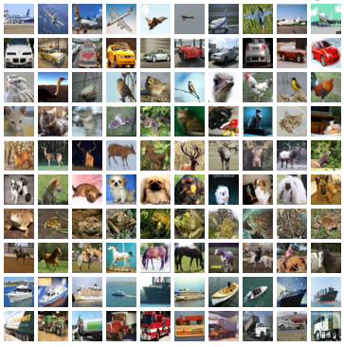
CIFAR-10 Dataset

Slide 29
Applications of CNN
Object detection
Face recognition
Scene labelling
Character or handwriting recognition.

Slide 30
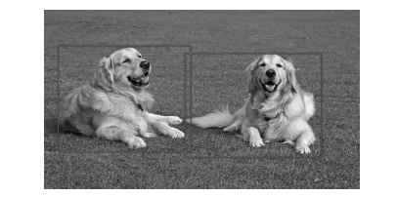
Object Detection
Object detection is a technology that deals with detecting real-world objects from a given scene.
The below image shows the detection of dogs from an input image.

Slide 31
Face Recognition
Face recognition is a problem that predicts whether there is a match between the face that is input and those available in the database.
Face recognition is affected by many problems, such as
1. Identifying all faces possible.
2. Focus on each face regardless of lighting and perspective.
3. Finding unique features to a face.
4. Comparing identified features with that available in the database.

Slide 32
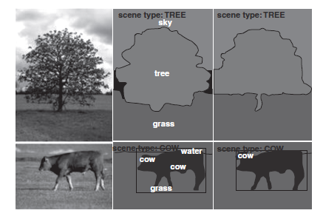
Scene Labeling
Scene labeling is the process of labeling every pixel in the given image with the category of the object it belongs.

Slide 33
Optical Character Recognition
OCR is one of the domains where CNN gives the best result.
However, we need a system that can recognize text in unconstrained images, where characters can be found anywhere on the image randomly with different formats.
For such cases, CNNs have proven to provide higher accuracy than most traditional approaches and other neural networks.

Slide 34
Handwritten Digit Recognition
Handwritten digit recognition problem is one of the object recognition problems.
Being a digit recognition problem, it becomes a 10-class (digits 0–9) classification problem.
A popular dataset that is available for this problem is the Modified National Institute of Standards and Technology (MNIST) dataset.

Slide 35
CNN Model for Emotion Recognition from Text
The CNN model described takes speech transcriptions, in the form of word embeddings, as input to detect emotion.
Transcription sequences (embedded vectors), which is the input to this model, are convolved with kernels of different sizes.
CNNs can directly be applied to word embeddings without prior information on their semantic contexts.
Word embedding describes feature learning and language modelling techniques where words and phrases from a given vocabulary are mapped to vectors or real numbers.
The maximum number of words in any given utterance is set to 128, which covers almost the entirety of the IEMOCAP dataset.
One feature from each of the different convolutional layers is picked by the max-pool layer.
These features are fed to a single FC layer.
Finally, a softmax layer is used to perform classification.

Slide 36
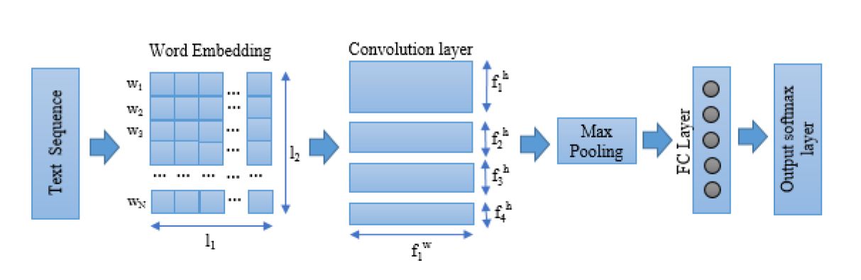
CNN Model for Emotion Recognition from Text

Slide 37
CNN Model for Emotion Recognition from Speech
A set of 4 parallel 2D convolutions are applied on the Spectrogram to extract its features.
The input shape of the Spectrogram image is 128 x 256 (number of Mels x number of windows).
The sizes of each of the kernels in their respective parallel CNN paths are 12 x 16, 18 x 24, 24 x 32, and 30 x 40.
The features generated in the said convolution layers are then fed to their respective max-pool layers, which extracts 4 features from each filter as the pool size is exactly half along the width and height of the convolution output.
The extracted features are fed to the Fully Connected (FC) layer. This model makes use of two FC layers of sizes 400 and 200.
Batch normalization is applied to both the FC layers.
The activation function used in the convolutional layers and the first FC layer is the Rectified Linear Unit (ReLU).
The output of the last FC layer is then fed to a Softmax layer, which classifies the input speech signal among 4 different emotion classes.

Slide 38
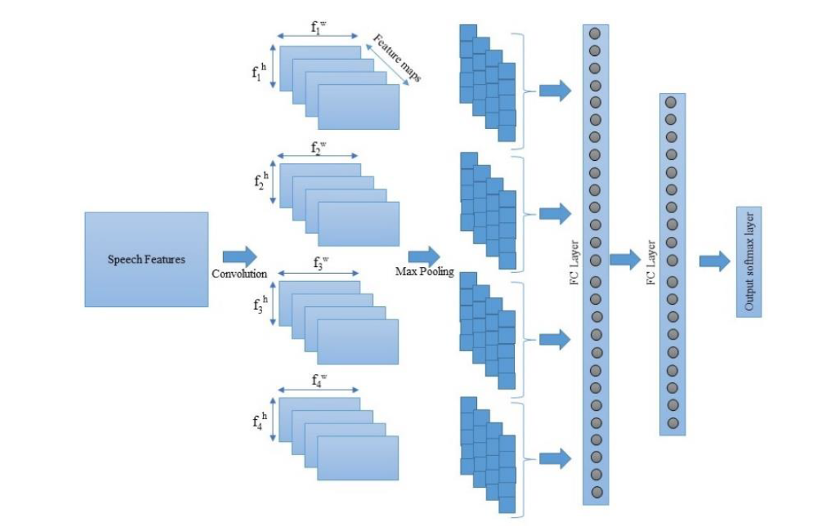
CNN Model with Spectrogram input

Slide 39
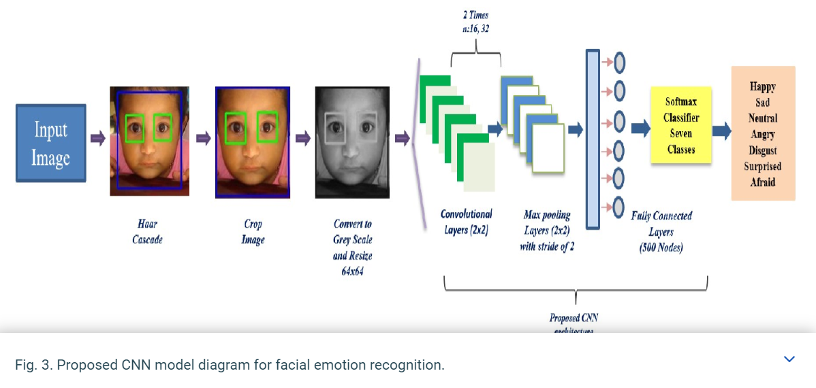
CNN Model for Emotion Recognition from Image
Notes:
crop and title
Example for facial exp using CNN model

Slide 40
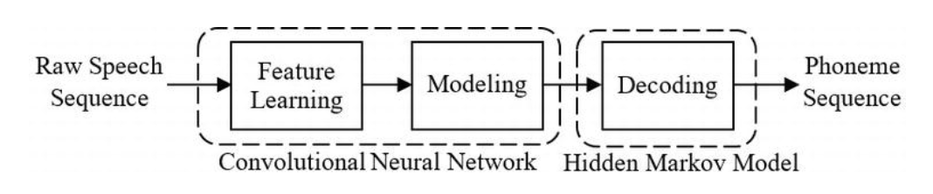
CNN-based raw speech phoneme recognition system

Slide 41
In this, raw speech signal is segmented into input speech signal
First convolutional layer learns the useful features from the raw speech signal, and remaining convolutional layers further process these features into the useful information
After processing the speech signal, CNN estimates the class conditional probability,
A filter stage is a combination of convolutional layer, pooling layer, and a nonlinearity. The joint training of feature stage and classifier stage is performed using the back-propagation algorithm.

Slide 42
Summary
CNN is composed of 3 layers – convolutional layer, pooling layer, fully connected layer.
Various pooling techniques include max pooling, average pooling and sum pooling. Each pooling technique has its own merits and demerits.
Both max pooling and sum pooling decrease the dimension of the input data efficiently retaining the features. On the other hand, average pooling may or may not detect all the features.
There are various activation functions that could be used in CNN hierarchy. ReLU is used to induce non-linearity in the network.

Slide 43
Summary
Output from the convolutional and pooling layers represent high-level features of the input image, which are passed on to the fully connected layer.
The fully connected layer classifies the input image into various classes of objects.
Image Classification using CNN on CIFAR Dataset.
Some real-time applications of CNN include object detection, handwritten OCR, face recognition and scene labelling.
Some of the famous CNN architecture include AlexNet, ZFNet, GoogleNet( Inception)and VGGNet.
Application of CNN for Emotion Recognition from different modalities.
CNN for feature extraction of speech signal for phoneme recognition.
Notes:
Some of these architectures in ImageNet Large Scale Visual Recognition Competition(ILSVRC)
AlexNet ILSVRC-2012
ZFNet ILSVRC-2013
GoogleNet ILSVRC-2014-winner
VGGNet ILSVRC-2014-runner

Slide 44
Conclusion
CNN is the preferred artificial neural network when it comes to analyzing visual imagery.
CNN proves to be the most efficient system for image and video recognition, recommender systems, image classification, medical image analysis, and natural language processing.

Slide 45
THANK YOU…

